Slide 1

SIT1305- MACHINE LEARNING
UNIT-II
Course In-Charges:
Dr.A.Mary Posonia
Dr.B.Ankayarkanni
SIT1305 Machine Learning

Slide 2
Regression
Supervised Learning
Statistical modeling to show the relationship between two variables with the linear Regression
Regression analysis is form of predictive modeling technique which investigates the relationship between a dependent and independent variable
SIT1305 Machine Learning

Slide 3
Uses of Regression Analysis
What is the strength of relationship between sales and marketing spending?
What is the relationship between age and income?
Agricultural scientists often use linear regression to measure the effect of fertilizer and water on crop yields.
Data scientists for professional sports teams often use linear regression to measure the effect that different training regimens have on player performance.
SIT1305 Machine Learning

Slide 4
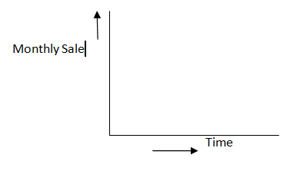
Where is Linear Regression Used?
Evaluating trends and sales estimates
Ex: Company sale has increased in every month for past few years
SIT1305 Machine Learning

Slide 5
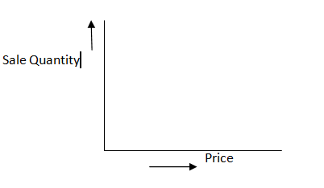
Where is Linear Regression Used?
- Analyzing the impact of price changes
Company increased the price of the product and the consumption of the product is reduced
- Helps us in future pricing decision
SIT1305 Machine Learning

Slide 6
Simple Linear Regression
The data is modeled using a straight line
Defining a straight line,
Y= b1x + b0
Where, x-> Independent variable
y-> Dependent variable
b1-> slope
b0-> y intercept
Correlation between x and y variable. Every value of x there is a corresponding value of y in it if it is a continuous
Linear regression maps the continuous value of x to the y
SIT1305 Machine Learning

Slide 7
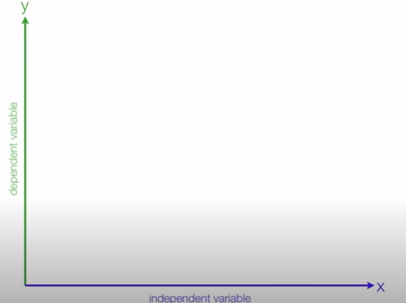
Simple Linear Regression
SIT1305 Machine Learning

Slide 8
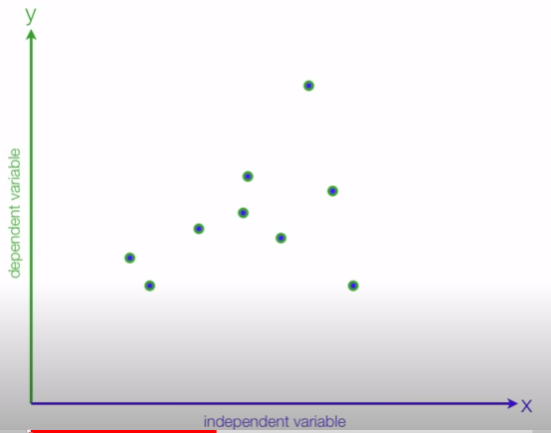
Plotting Data Points
- Now start plotting a data points and form a regression line
SIT1305 Machine Learning

Slide 9
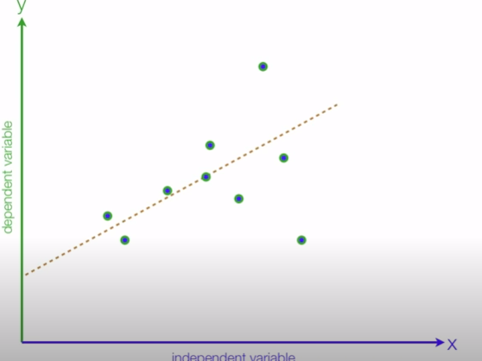
Regression Line
- Try to fit a line on data points and when new data arise modify excising model, Linear regression is not good for classification
SIT1305 Machine Learning

Slide 10
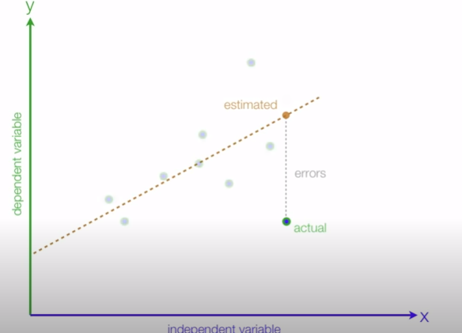
Simple Linear Regression
Once the regression line is formed the start the prediction
Goal of the best fit line is reduce the error between estimated and actual value or minimize the erroe
SIT1305 Machine Learning

Slide 11
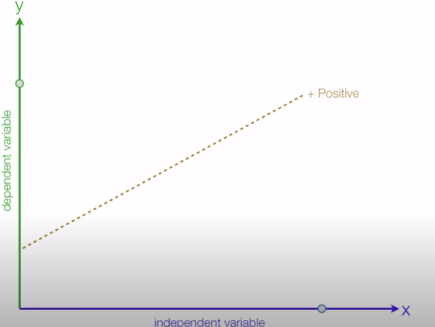
Simple Linear Regression
- If data point in X axis increases then increase in Y axis value called positive slope
SIT1305 Machine Learning

Slide 12
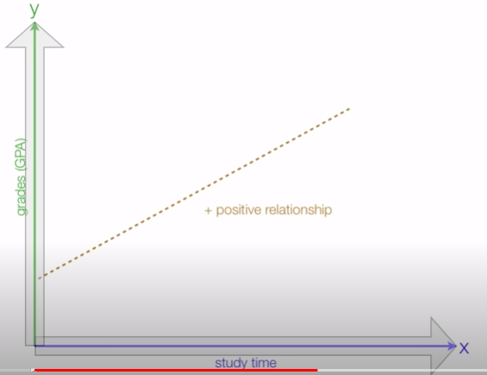
Example
SIT1305 Machine Learning

Slide 13
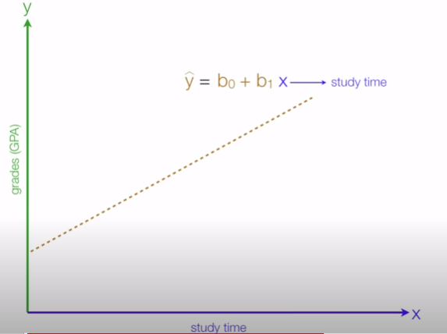
Example
SIT1305 Machine Learning

Slide 14
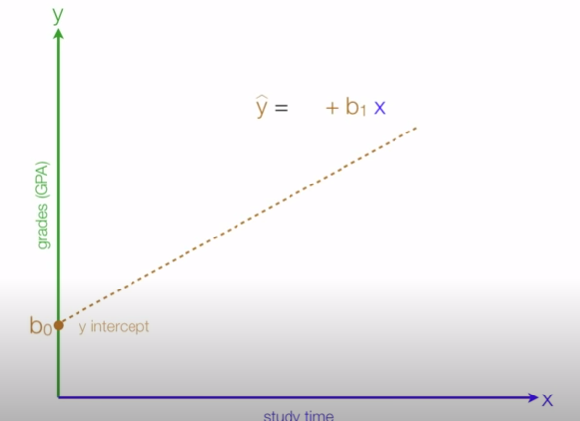
Example
SIT1305 Machine Learning

Slide 15
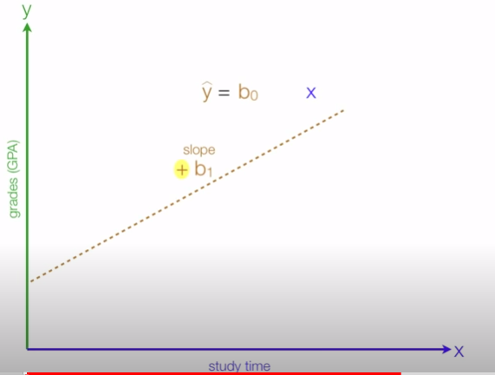
Example
SIT1305 Machine Learning

Slide 16
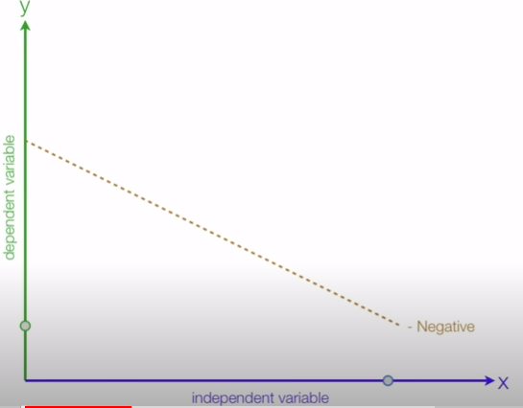
Simple Linear Regression
- If data point in X increasing and dependent variable Y decreasing called negative slope
SIT1305 Machine Learning

Slide 17
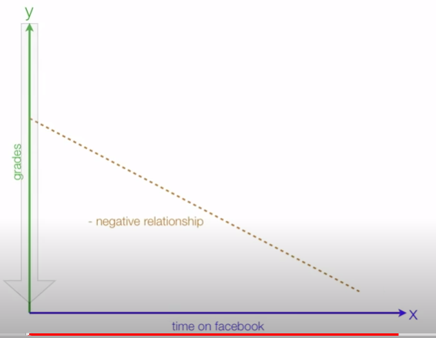
Example
SIT1305 Machine Learning

Slide 18
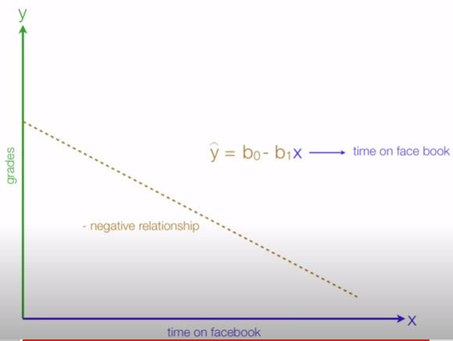
Example
SIT1305 Machine Learning

Slide 19
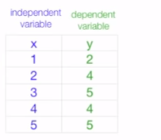
Understanding Linear Regression Algorithm
SIT1305 Machine Learning

Slide 20
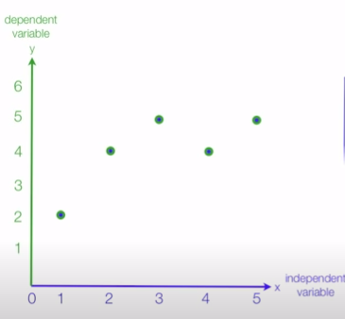
Step 1: Plot Data
SIT1305 Machine Learning

Slide 21


Step 2: Calculate Slope
- Straight line Formula
- The slope b1 is:
SIT1305 Machine Learning

Slide 22

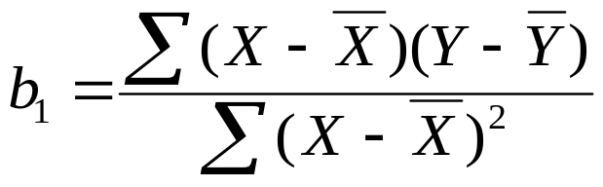




Step 3: Find Regression Line
 | X | Y
 | 1 | 2
 | 2 | 4
 | 3 | 5
 | 4 | 4
 | 5 | 5
Mean | 3 | 4
Linear Model:
Mean X and Y
X | Y
1 | 2 | -2 | -2 | 4 | 4
2 | 4 | -1 | 0 | 1 | 0
3 | 5 | 0 | 1 | 0 | 0
4 | 4 | 1 | 0 | 1 | 0
5 | 5 | 2 | 1 | 4 | 2
3 | 4 |  |  | 10 | 6
SIT1305 Machine Learning

Slide 23
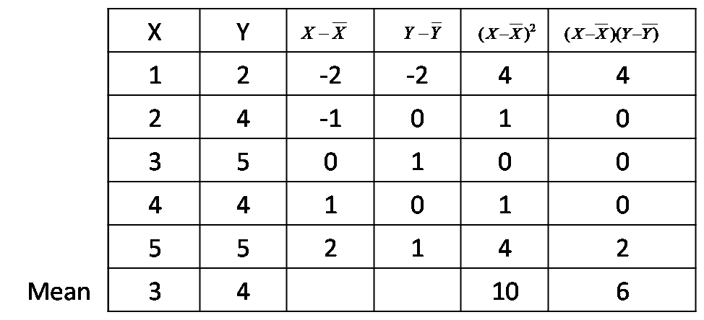
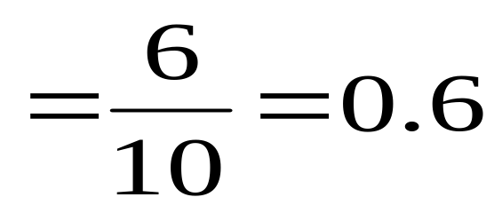
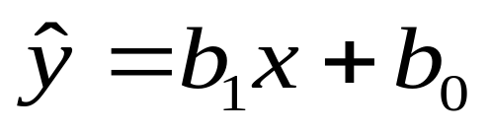
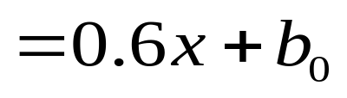
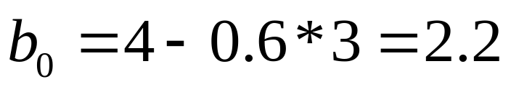
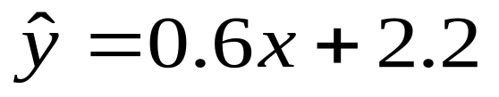
At mean (3,4)
Model
SIT1305 Machine Learning

Slide 24
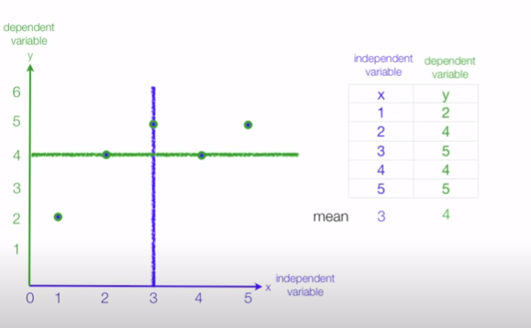
Regression Line
SIT1305 Machine Learning

Slide 25
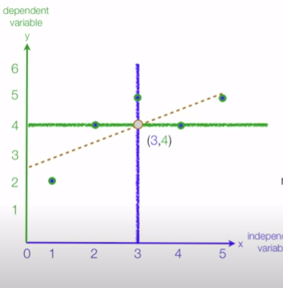
Regression Line
SIT1305 Machine Learning

Slide 26
Regression Line
Y(Predicted)= 0.6 X +2.2
For given b1= 0.6 and b0= 2.2, lets predict values for Y for X ={ 1,2,3,4,5}
Y(predicted)=0.6 *1+2.2 = 2.8
Y(predicted) = 0.6 *2+2.2 =
Y(predicted) =
Y(predicted) =
Y(predicted) =
SIT1305 Machine Learning

Slide 27
Mean squared Error
Now task is distance between actual and predicted value and reduce the error or reduce the distance
The line with least error is line of Regression
With the change of slope b1 changes in predicted value, select the minimum error
R- Squared – Value is a statistical measure of how close the data to be fitted in regression line
SIT1305 Machine Learning

Slide 28
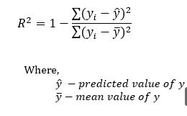
SIT1305 Machine Learning

Slide 29

R- squared co-efficient of determination
-If R² ≃ 0.3 – Data points are for away from regression line
- If R² ≃ 0.7 – Data points are closer to regression line
SIT1305 Machine Learning

Slide 30
Advantages
Computational Complexity : Computationally simple compare to decision tree or clustering algorithm
Data Quality: Outliers can disturb the model so if we remove outliers we will get a good model
SIT1305 Machine Learning

Slide 31
Problem 2:
The values of x and their corresponding values of y are shown in the table below:
a) Find the least square regression line y = a x + b.
b) Estimate the value of y when x = 10.
x | 1 | 2 | 3 | 4 | 5
y | 3 | 4 | 2 | 4 | 5
SIT1305 Machine Learning

Slide 32
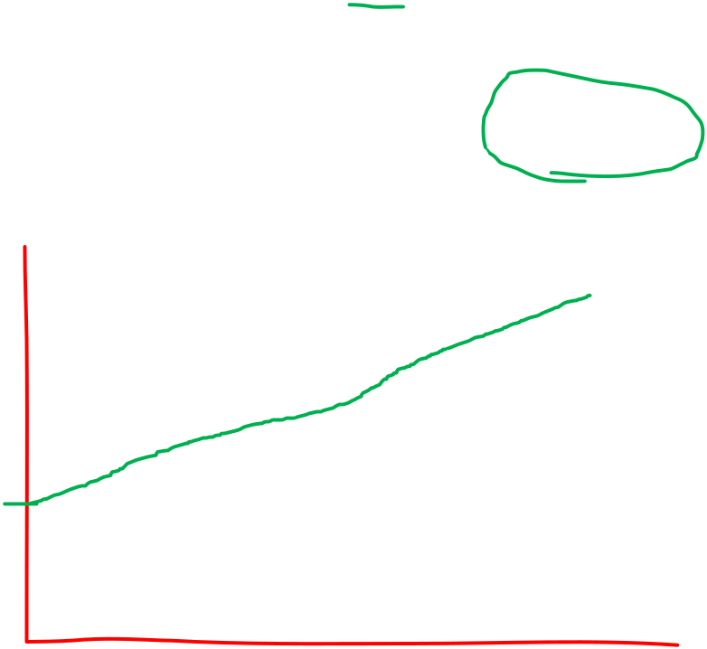
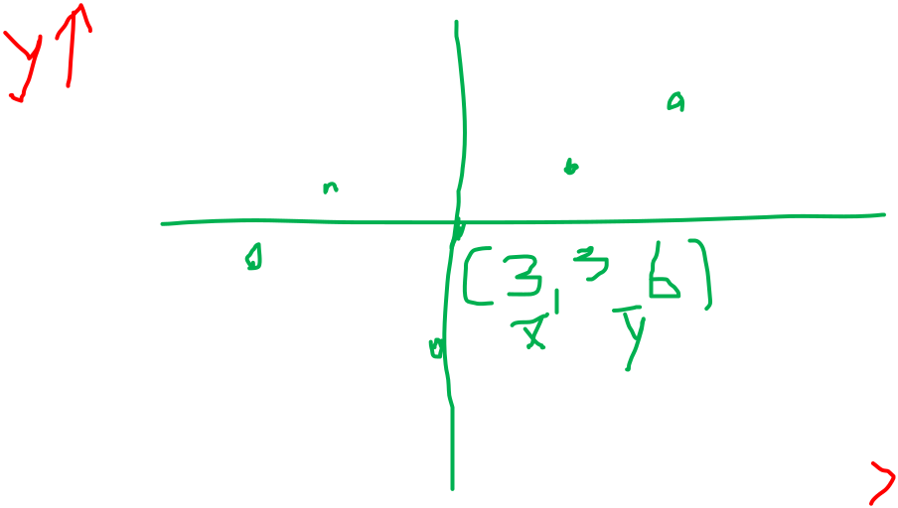

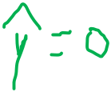



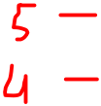





x | 1 | 2 | 3 | 4 | 5
y | 3 | 4 | 2 | 4 | 5
X- mean=3 , y-mean = 3.6 b0 =2.4
SIT1305 Machine Learning

Slide 33
Problem 3:
The sales of a company (in million dollars) for each year are shown in the table below.
a) Find the least square regression line y = a x + b.
b) Use the least squares regression line as a model to estimate the sales of the company in 2012.
X(year) | 2005 | 2006 | 2007 | 2008 | 2009
Y(sales) | 12 | 19 | 29 | 37 | 45
SIT1305 Machine Learning

Slide 34
X(year) | 0 | 1 | 2 | 3 | 4
Y(sales) | 12 | 19 | 29 | 37 | 45
x-mean= y-mean= b0=
SIT1305 Machine Learning

Slide 35
BAYESIAN CLASSIFICATION
SIT1305 Machine Learning

Slide 36
Introduction
Supervised Learning
Bayesian classifiers are the statistical classifiers based on Bayes' Theorem
Bayesian classifiers can predict class membership probabilities i.e. the probability that a given tuple belongs to a particular class.
It uses the given values to train a model and then it uses this model to classify new data
SIT1305 Machine Learning

Slide 37
Where is it used?
Trying to find the answer
There are only two possible events possible for the given question:
A: It is going to rain tomorrow
B: It will not rain tomorrow.
If you think intuitively
● It's either going to be raining today or it is NOt going to be raining today
● So technically there is 50% CHANCE OF RAIN tomorrow. Correct?
SIT1305 Machine Learning

Slide 38
Bayes Approach
Bayesian theorem argues that the probability of an event taking place changes if there is information available about a related event.
EX: This means that if you recall the previous weather conditions for the last week, and you remember that it has actually rained every single day, your answer will no longer be 50% .
The Bayesian approach provides a way of explaining how you should change your existing beliefs in the light of new evidence.
SIT1305 Machine Learning

Slide 39
What is Bayes Theorem?
Bayes' theorem, named after 18th-century British mathematician Thomas Bayes, is a mathematical formula for determining conditional probability
The theorem provides a way to revise existing predictions or theories given new or additional evidence.
In finance, Bayes' theorem can be used to rate the risk of lending money to potential borrowers.
SIT1305 Machine Learning

Slide 40
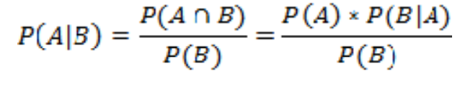
Bayes Formula
The formula for the Bayes theorem is given as follows:
Bayes' theorem is also called Bayes' Rule or Bayes' Law
SIT1305 Machine Learning

Slide 41
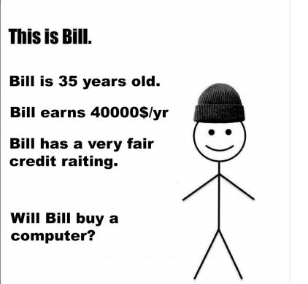
Example Scenario
SIT1305 Machine Learning

Slide 42
Bayes theorem
P(H|X) = P(X|H) * P(H) / P(X)
H: Hypothesis that Bill will buy the computer
X : Bill is 35 years old with fair credit rating and income of 40000$/year
P(H|X) : The probability that Bill will buy the computer GIVEN that we know his age, income and credit rating [Posterior ]
P(H) : Probability that Bill will buy computer (REGARDLESS of knowing age, income and credit rating) [Prior]
P(X|H) : Probability that someone is 35 years old, has fair credit rating, earns 40000$/yr AND has BOUGHT the computer. [Likelihood]
P(X) : Probability that Bill is 35 years old, has fair credit rating, earns 40000$/yr [Evidence]
SIT1305 Machine Learning

Slide 43
What are Bayesian Classifiers?
Statistical classifiers.
Predict class membership probabilities, such as the probability that a given tuple belongs to a particular class.
Based on Bayes’ theorem
Exhibits high accuracy and speed when applied to large databases.
SIT1305 Machine Learning

Slide 44
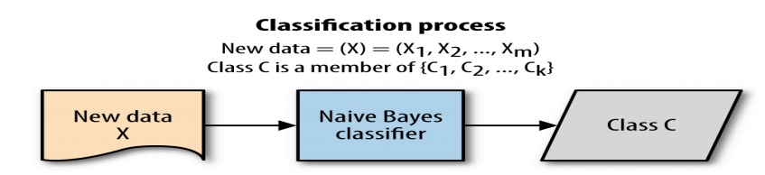
Naive Bayes Classification
Before explaining the mathematical representations, let us see the basic principle of Bayesian classification :
Predict the most probable class for each instance. How ?
Find out the probability of the previously unseen instance belonging to each class, and then select the most probable class.
SIT1305 Machine Learning

Slide 45
Naive Bayes Classification
A Naive Bayes Classifier is a program which predicts a class value given a set of attributes. For each known class value,
Calculate probabilities for each attribute, conditional on the class value.
Use the product rule to obtain a joint conditional probability for the attributes.
Use Bayes rule to derive conditional probabilities for the class variable. Once this has been done for all class values, output the class with the highest probability.
SIT1305 Machine Learning

Slide 46
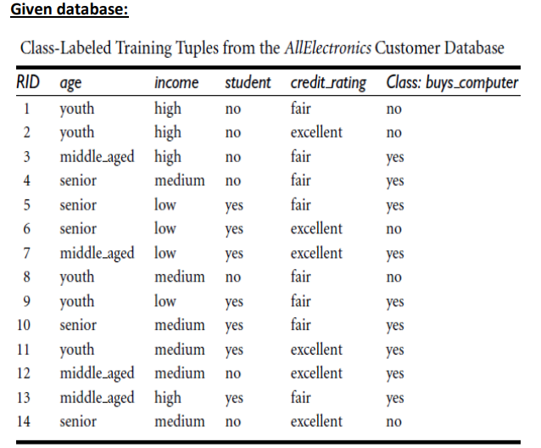
Example: Problem
SIT1305 Machine Learning

Slide 47
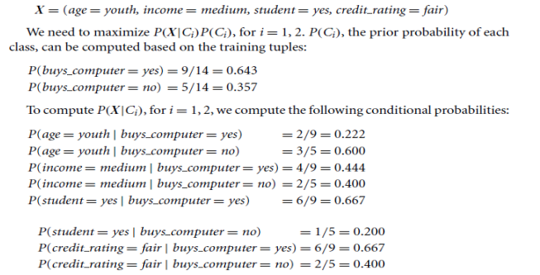
Example
SIT1305 Machine Learning

Slide 48
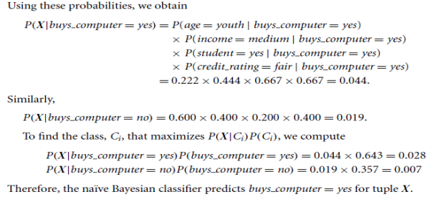
Example
SIT1305 Machine Learning

